Slide 1
System Programming

Slide 2
Introduction
What is System?
System is the collection of various components
Ex:- College is a system
What is Programming?
Art of designing and implementing the programs.

Slide 3
What is Software ?
Software is collection of many programs
Two types of software
System software
These programs assist general use application programs
Ex:- Operation System , Assembler etc.
Application software
These are the software developed for the specific goal

Slide 4
System Program:-
“These are programs which are required for the effective execution of general user programs on computer system.”
System Programming:-
“ It is an art of designing and implementing system programs.”

Slide 5
Components of System Programming
Interpreter
Assembler
Compiler
Macros and Microprocessors
Formal systems
Debugger
Linkers
Operating system

Slide 6
Need Of System Software
The basic need of system software is to achieve the following goals :-
To achieve efficient performance of the system
To make effective execution of general user program
To make effective utilization of human resources
To make available new, better facilities

Slide 7
Operating System
It is the collection of system programs which acts as an interface between user and the computer and computer hardware.
The purpose of an operating system is to provide an environment in which A user can execute programs in a convenient manner

Slide 8
Functions of Operating System
File handling and management.
Storage management (Memory management).
Device scheduling and management.
CPU scheduling.
Information management.
Process control (management).
Error handling
Protecting itself from user & protecting user from other users.

Slide 9
Translators
These are the system programs that converts the source program into computer understandable fashion
Types of translators
Single Pass translator
Multi Pass translator

Slide 10
Translators
Assembler:-
These are the system programs which will automatically translate the assembly language program in to the machine language program
Source program
Assembly Lang. Prog.
Target program /
M/C Lang. Prog.
Assembler
Database

Slide 11
Translators
Complier:-
These are the system programs which will automatically translate the High level language program in to the machine language program
Source program
High level Lang. Prog.
Target program /
M/C Lang. Prog.
Compiler
Database

Slide 12
Translators
Cross Assembler:-
These are the system programs which will automatically translate the Assembly Language program compatible with M/C A, in to the machine language program compatible with M/C A, but the underlying M/C is M/C B
Source program
Assembly Lang. Prog. Compatible with M/C A
Target program /
M/C Lang. Prog. Compatible with M/C A
Cross Assembler
M/C B

Slide 13
Translators
Cross Compiler:-
These are the system programs which will automatically translate the HLL program compatible with M/C A, in to the machine language program compatible with M/C A , but the underlying M/C is M/C B
Source program
HLL Prog. Compatible with M/C A
Target program /
M/C Lang. Prog.
Cross Compiler
M/C B

Slide 14
Translators
Interpreter
It is the language translator which execute source program line by line with out translating them into machine language.
Types of Interpreter
Pure Interpreter
In this case no preprocessing is required on source program before an interpretation starts.
Some preprocessing is required on source program before an interpretation starts.

Slide 15
Loader
A Loader is system program that place the object program into main memory and prepares it for execution.
Basic functions of loader
Allocation
Linking
Relocation
Loading

Slide 16
Types of Loader
Compile-and-go Loader
Relocating Loader
Direct Linking Loader
Absolute Loader
General Loader
Dynamic Loader

Slide 17
Macro & Macro processor
Macro
Macro is a single line abbreviation for a group of instruction.
MACRO --------Start of definition
INCR -------- Macro name
A 1,DATA
A 2,DATA Sequence of instructions to be abbreviated.
A 3,DATA
MEND -------- End of definition

Slide 18
Linking and Linker
Linking
The Process of merging many object modules to form a single object program is called as linking.
Linker
The Linker is the software program which binds many object modules to make a single object program.

Slide 19
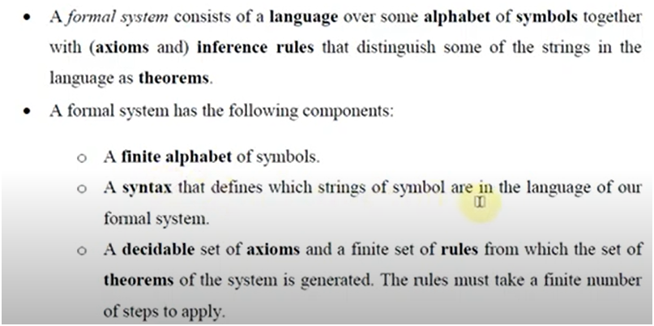
Formal System
A formal system is an un interpreted calculus. It consists of
Alphabets
A set of words called Axioms.
Finite set of relations called rules of inference or production rules.
Ex Boolean algebra.

Slide 20
Types of Assembly Language statements
Imperative statements
An imperative statement in assembly language indicates the action to be performed during execution of assembly statement
Ex:- A 1,FOUR

Slide 21
Declarative Statement:-
These statements declares the storage area or declares the constant in program.
EX A DS 1
ONE DC “1”

Slide 22
Assembler Directives
These are the statements used to indicate certain thing regarding how assembly of input program is to be performed.
Ex START 100
USING *, 15

Slide 23
Types of Assembler
Single pass Assembler
Multi pass Assembler

Slide 24
Problem of Forward Reference
When the variables are used before their definition at that time problem of forward reference accurse.

Slide 25
Problem of Forward Reference
JOHN START 0
USING *, 15
L 1, FIVE
A 1,FOUR
ST 1, TEMP
FOUR DC F’4’
FIVE DC F’5’
TEMP DS 1F
END

Slide 26
General Design Procedure of Two Pass Assembler
Specify the problem
Specify data structures
Define format of data structures
Specify algorithm
Look for modularity [capability of one program to be subdivided into independent programming units.]
Repeat 1 through 5 on modules.

Slide 27
SOURCE PROGRAM | FIRST PASS | SECOND PASS
RAM START 0 USING *, 15 L 1, FIVE A 1,FOUR ST 1, TEMP FOUR DC F’4’ FIVE DC F’5’ TEMP DS 1F END | 0 L 1,_(0,15) 4 A 1,_(0,15) 8 ST 1,_(0,15) 12 4 16 5 20 -- | 0 L 1, 16(0,15) 4 A 1, 12(0,15) 8 ST 1, 20(0,15) 12 4 16 5 20 --

Slide 28
Specify the problem
Pass1: Define symbols & literals.
1) Determine length of m/c instruction [MOTGET1]
2) Keep track of Location Counter [LC]
3) Remember values of symbols [STSTO]
4) Process some pseudo ops[EQU,DS etc] [POTGET1]
5) Remember Literals [LITSTO]

Slide 29
Pass2: Generate object program
1) Look up value of symbols [STGET]
2) Generate instruction [MOTGET2]
3) Generate data (for DS, DC & literals)
4) Process pseudo ops [POTGET2]

Slide 30
Step 2. Data structure:-
Pass1: Databases
Input source program
“LC” location counter used to keep track of each instructions addr.
M/c operation table (MOT) [Symbolic mnemonic & length]
Pseudo operation table [POT], [Symbolic mnemonic & action]
Symbol Table (ST) to store each lable & it’s value.
Literal Table (LT), to store each literal (variable) & it’s location.
Copy of input to used later by PASS-2.

Slide 31
Step 2. Data structure:-
Pass2: Databases
Copy of source program input to Pass1.
Location Counter (LC)
MOT [Mnemonic, length, binary m/c op code, etc.]
POT [Mnemonic & action to be taken in Pass2
ST [prepared by Pass1, label & value]
Base Table [or register table] indicates which registers are currently specified using ‘USING’ pseudo op & what are contents.
Literal table prepared by Pass1. [Lit name & value].

Slide 32
Format of Data Structures
Machine Operation Table
The op-code is the key and it’s value is the binary op code equivalent, which is used for use in generating machine code.
The instruction length is stored for updating the location counter.
Instruction format is use in forming the m/c language equivalent

Slide 33
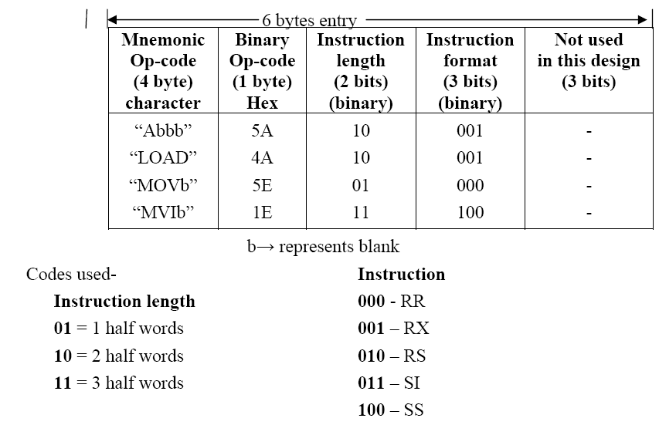

Slide 34
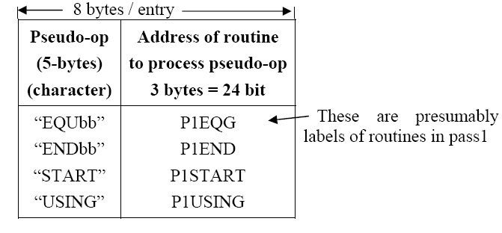
Pseudo Operation Table

Slide 35
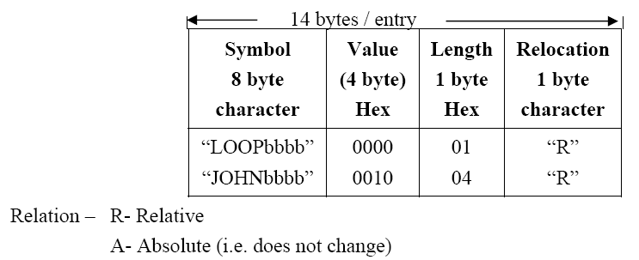
Symbol table & Literal table:-

Slide 36
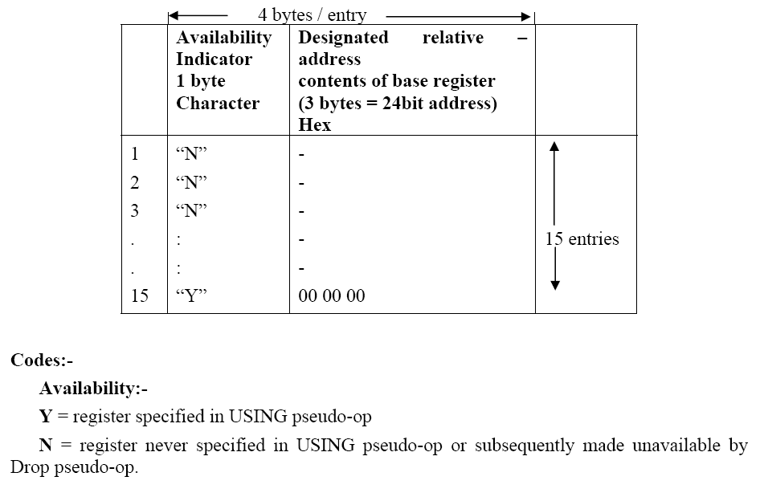
Base table

Slide 37
Pass – I of ASSEMBLER

Slide 38
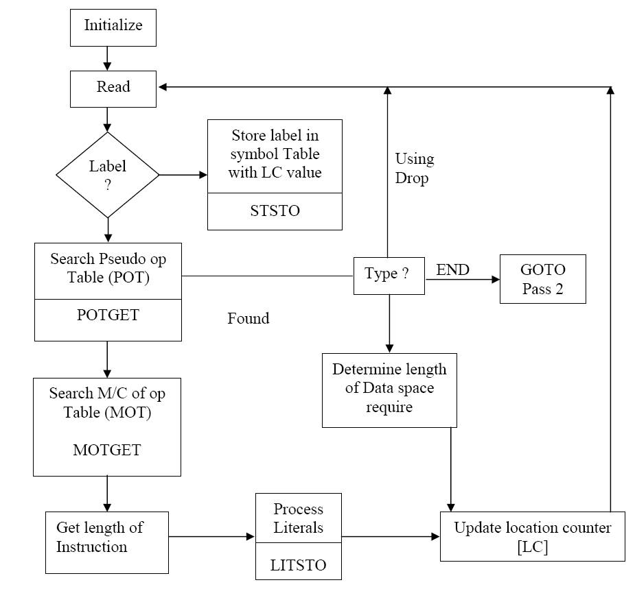

Slide 39
Pass-II Assembler

Slide 40
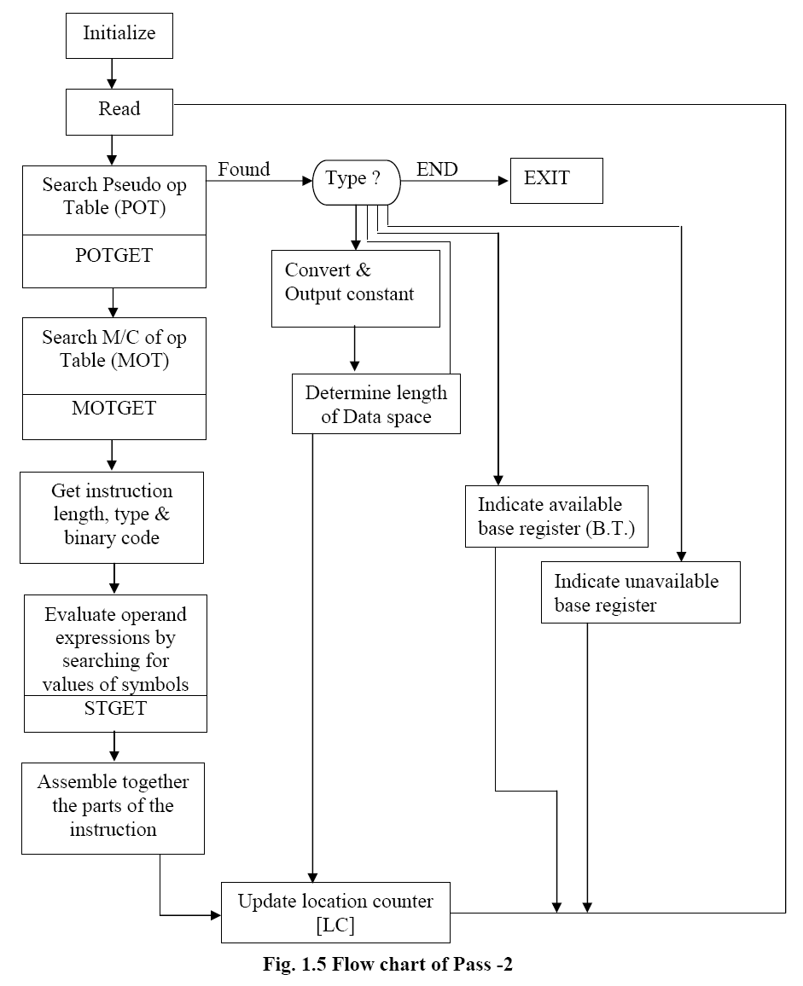

Slide 41
Machine Dependent and Machine Independent features of Assembler
M/C Dependent Features
A] Instruction format & addr. mode:-
B] Program Relocation
Machine Independent Assembler Features
1) Literals
2) Symbol defining statements
3) Expressions

